Slide 1

502070
Web Application Development Using NodeJS
CHAPTER 1: INTRODUCTION TO NODEJS
LESSON 01 – INTRODUCTION TO NODEJS

Slide 2
OUTLINE
What is Node.js?
Node.js Get Started
Node.js Modules
Node.js HTTP Module
Node.js URL module
Node.js NPM

Slide 3
OUTLINE
What is Node.js?
Node.js Get Started
Node.js Modules
Node.js HTTP Module
Node.js URL module
Node.js NPM

Slide 4
1. What is Node.js?
Node.js is an open source server environment
Node.js is free
Node.js runs on various platforms (Windows, Linux, Unix, Mac OS X, etc.)
Node.js uses JavaScript on the server

Slide 5
Why Node.js?
Node.js uses asynchronous programming!
Node.js runs single-threaded, non-blocking, asynchronously programming, which is very memory efficient.
How PHP or ASP handles a file request | How Node.js handles a file request
1. Sends the task to the computer's file system. 2. Waits while the file system opens and reads the file. 3. Returns the content to the client. 4. Ready to handle the next request. | 1. Sends the task to the computer's file system. 2. Ready to handle the next request. 3. When the file system has opened and read the file, the server returns the content to the client.

Slide 6
What Can Node.js Do?
Node.js can generate dynamic page content
Node.js can create, open, read, write, delete, and close files on the server
Node.js can collect form data
Node.js can add, delete, modify data in your database

Slide 7
What is a Node.js File?
Node.js files contain tasks that will be executed on certain events
A typical event is someone trying to access a port on the server
Node.js files must be initiated on the server before having any effect
Node.js files have extension ".js"

Slide 8
OUTLINE
What is Node.js?
Node.js Get Started
Node.js Modules
Node.js HTTP Module
Node.js URL module
Node.js NPM

Slide 9
Node.js Get Started
helloworld.js
var http = require('http'); http.createServer(function (req, res) { res.writeHead(200, {'Content-Type': 'text/html'}); res.end('Hello World!'); }).listen(8080);

Slide 10
Node.js Get Started
Download Node.js: https://nodejs.org
Node.js files must be initiated in the "Command Line Interface" program of your computer.
Start your command line interface, write “node helloworld.js” and hit enter.
Start your internet browser, and type in the address: http://localhost:8080

Slide 11
OUTLINE
What is Node.js?
Node.js Get Started
Node.js Modules
Node.js HTTP Module
Node.js URL module
Node.js NPM

Slide 12
Node.js Modules
Consider modules to be the same as JavaScript libraries.
Node.js has a set of built-in modules which you can use without any further installation.
To include a module, use the require() function with the name of the module:
var http = require('http');

Slide 13
Create Your Own Modules
You can create your own modules, and easily include them in your applications.
Create a module that returns the current date and time:
exports.myDateTime = function () { return Date(); };
Use the exports keyword to make properties and methods available outside the module file.
Save the code above in a file called "myfirstmodule.js"

Slide 14
Include Your Own Module
Now you can include and use the module in any of your Node.js files.
var http = require('http'); var dt = require('./myfirstmodule'); http.createServer(function (req, res) { res.writeHead(200, {'Content-Type': 'text/html'}); res.write("The date and time are currently: " + dt.myDateTime()); res.end(); }).listen(8080);

Slide 15
OUTLINE
What is Node.js?
Node.js Get Started
Node.js Modules
Node.js HTTP Module
Node.js URL module
Node.js NPM

Slide 16
The Built-in HTTP Module
Node.js has a built-in module called HTTP, which allows Node.js to transfer data over the Hyper Text Transfer Protocol (HTTP).
To include the HTTP module, use the require() method:
var http = require('http');

Slide 17
Node.js as a Web Server
The HTTP module can create an HTTP server that listens to server ports and gives a response back to the client.
Use the createServer() method to create an HTTP server:
var http = require('http'); //create a server object: http.createServer(function (req, res) { res.write('Hello World!'); //write a response to the client res.end(); //end the response }).listen(8080); //the server object listens on port 8080

Slide 18
Add an HTTP Header
If the response from the HTTP server is supposed to be displayed as HTML, you should include an HTTP header with the correct content type:
var http = require('http'); http.createServer(function (req, res) { res.writeHead(200, {'Content-Type': 'text/html'}); res.write('Hello World!'); res.end(); }).listen(8080);

Slide 19
Read the Query String
The function passed into the http.createServer() has a req argument that represents the request from the client, as an object (http.IncomingMessage object).
This object has a property called "url" which holds the part of the url that comes after the domain name:
var http = require('http'); http.createServer(function (req, res) { res.writeHead(200, {'Content-Type': 'text/html'}); res.write(req.url); res.end(); }).listen(8080);
Visit: http://localhost:8080/summer

Slide 20
OUTLINE
What is Node.js?
Node.js Get Started
Node.js Modules
Node.js HTTP Module
Node.js URL module
Node.js NPM

Slide 21
Split the Query String
There are built-in modules to easily split the query string into readable parts, such as the URL module.
var http = require('http'); var url = require('url'); http.createServer(function (req, res) { res.writeHead(200, {'Content-Type': 'text/html'}); var q = url.parse(req.url, true).query; var txt = q.year + " " + q.month; res.end(txt); }).listen(8080);
Visit: http://localhost:8080/?year=2020&month=December

Slide 22
The Built-in URL Module
The URL module splits up a web address into readable parts.
To include the URL module, use the require() method:
var url = require('url’);
Parse an address with the url.parse() method, and it will return a URL object with each part of the address as properties:
var url = require('url'); var adr = 'http://localhost:8080/default.htm?year=2017&month=february'; var q = url.parse(adr, true); console.log(q.host); //returns 'localhost:8080' console.log(q.pathname); //returns '/default.htm' console.log(q.search); //returns '?year=2017&month=february' var qdata = q.query; //returns an object: { year: 2017, month: 'february' } console.log(qdata.month); //returns 'february'

Slide 23
Node.js File Server
summer.html:
<!DOCTYPE html> <html> <body> <h1>Summer</h1> <p>I love the sun!</p> </body> </html>

Slide 24
Node.js File Server
winter.html:
<!DOCTYPE html> <html> <body> <h1>Winter</h1> <p>I love the snow!</p> </body> </html>

Slide 25
Node.js File Server
Create a Node.js file that opens the requested file and returns the content to the client. If anything goes wrong, throw a 404 error::
var http = require('http'); var url = require('url'); var fs = require('fs'); http.createServer(function (req, res) { var q = url.parse(req.url, true); var filename = "." + q.pathname; fs.readFile(filename, function(err, data) { if (err) { res.writeHead(404, {'Content-Type': 'text/html'}); return res.end("404 Not Found"); } res.writeHead(200, {'Content-Type': 'text/html'}); res.write(data); return res.end(); }); }).listen(8080);

Slide 26
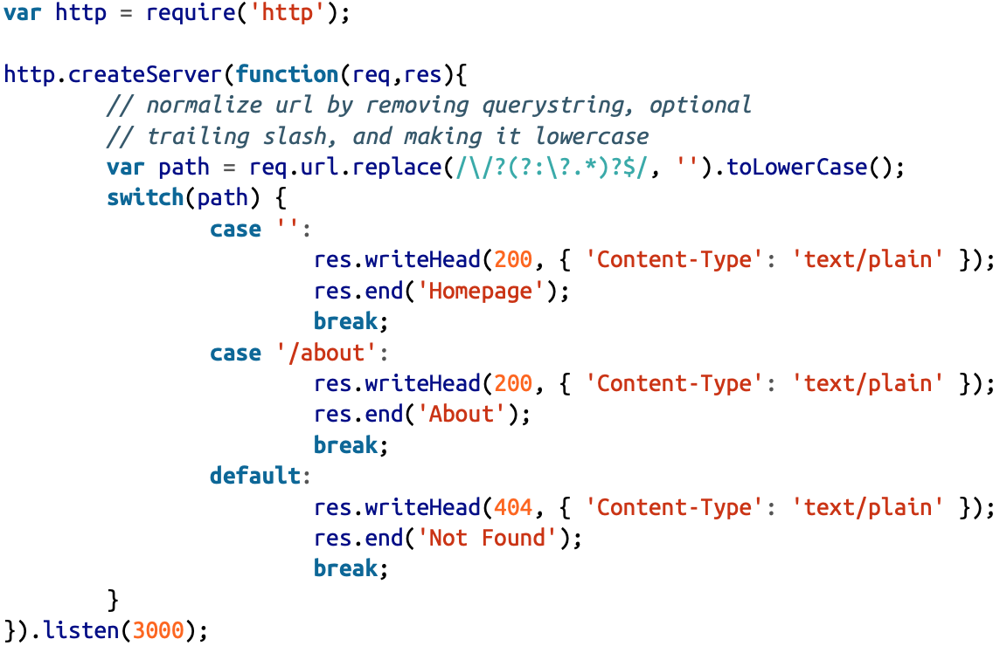
Routing
Routing refers to the mechanism for serving the client the content it has asked for.

Slide 27
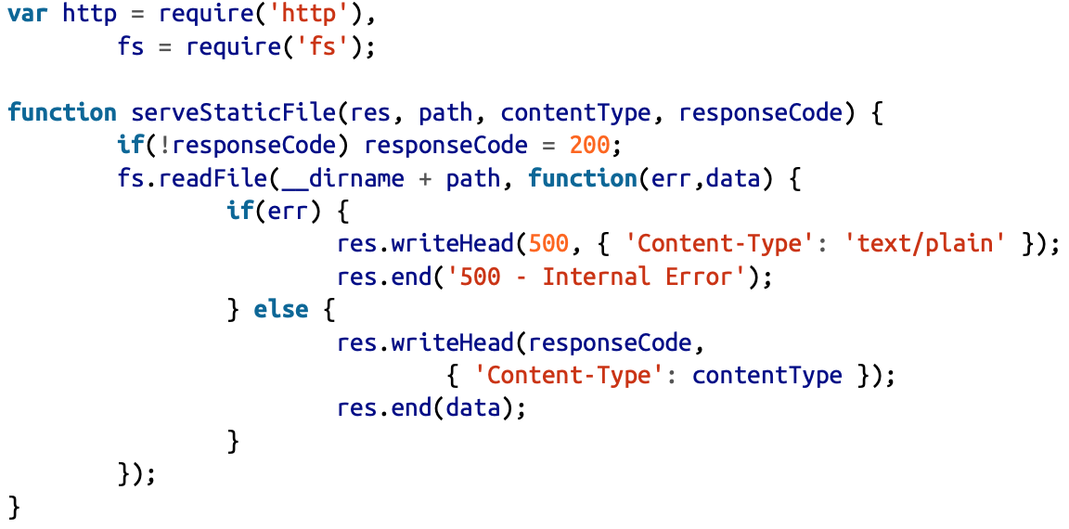
Serving Static Resources
We need to open the file, reading it, and then sending its contents along to the browser.

Slide 28
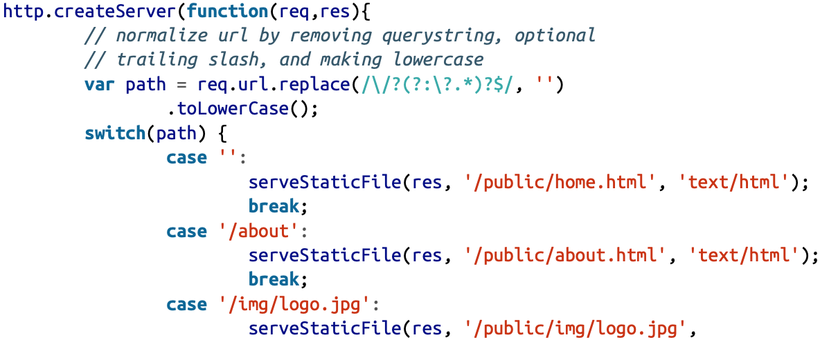
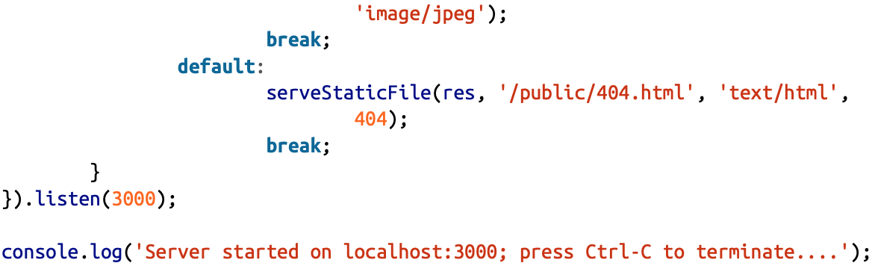
Serving Static Resources

Slide 29
OUTLINE
What is Node.js?
Node.js Get Started
Node.js Modules
Node.js HTTP Module
Node.js URL module
Node.js NPM

Slide 30
What is NPM?
NPM is a package manager for Node.js packages, or modules if you like.
www.npmjs.com hosts thousands of free packages to download and use.
The NPM program is installed on your computer when you install Node.js

Slide 31
What is a Package?
A package in Node.js contains all the files you need for a module.
Modules are JavaScript libraries you can include in your project.

Slide 32
Download a Package
Downloading a package is very easy.
Open the command line interface and tell NPM to download the package you want.
I want to download a package called "upper-case":
npm install upper-case
NPM creates a folder named "node_modules", where the package will be placed. All packages you install in the future will be placed in this folder.

Slide 33
Using a Package
Once the package is installed, it is ready to use.
Include the "upper-case" package the same way you include any other module:
var uc = require('upper-case’);
Create a Node.js file that will convert the output "Hello World!" into upper-case letters:
var http = require('http'); var uc = require('upper-case'); http.createServer(function (req, res) { res.writeHead(200, {'Content-Type': 'text/html'}); res.write(uc.upperCase("Hello World!")); res.end(); }).listen(8080);

